Slide 1
Elder Fraud
Those aged 60+ were the most victimized.
Those aged 30-39 registered more complaints of fraud.
WHY???
In 2023:
Financial fraud schemes directly targeting elderly and/or vulnerable individuals where trust is gained and abused to cause financial damage and harm.
The National Council of Aging estimates $3.4 Billion in loss per year.
Often unreported.
Perpetrated by both trusted individuals and strangers.
Notes:
It is an act of psychological and/or digital manipulation using fake online personas to induce trust in unwitting victims to cause harm.

Slide 2
Romance Scam
Methods Used in Romance Scams:
Dating apps/websites, social media.
Attractive online profile.
Claim to be stationed overseas as a member of the U.S. military,
residing in another state or living abroad due to personal reasons or
visa issues.
Strong emotions are established in short time period.
Money is requested for an “emergency” (medical/legal).
Send or request to buy expensive items (laptop/cell phone) to re-ship.
Request banking details to receive large deposits (mule).
Some are bold and will call or FaceTime but will always have an
excuse preventing them from meeting in person.

Slide 3
Investment Scams
Methods used in Investment Scams:
Contacted through a wrong number text, dating app, social media.
Change communication platform.
Discuss crypto and invite victim to invest.
Provide evidence (screenshots) of large returns, their own financial gain.
Express urgency of action to avoid loss of profit.
Following loss of initial investment, will request larger deposit.
Express empathy over loss investment and offer future opportunity.

Slide 4
Technical Support Scams
Methods used in Tech Scam:
Pop-up warnings appear on your computer/phone with logos from trusted companies/websites.
Online ads and listings appear in search results.
Phone calls come in with trusted company name appearing on caller ID.
Receive emails with trusted company name.
Victim calls the number provided to
speak with a representative from the
company who will “help” with your
computer/phone problem.

Slide 5
Overpayment Scam
Methods used in Overpayment Scam:
Online sales/classified ads.
Payment through PayPal, etc. in excess of the amount of purchase.
Payment through paper check in excess of the amount of purchase.
Payment through credit/preloaded money card in excess of amount of purchase.
Request for extra payment to be sent to specific bank account via wire transfer.
Notes:
Overpayment Scam – also known as a cash forwarding or advance payment scheme.
Uses stolen credit card to initiate a transaction then offer to overpay the total amount due
Respond to an ad and issue a cashier’s check, personal check, corporate check for more than the amount due, you give them refund

Slide 6
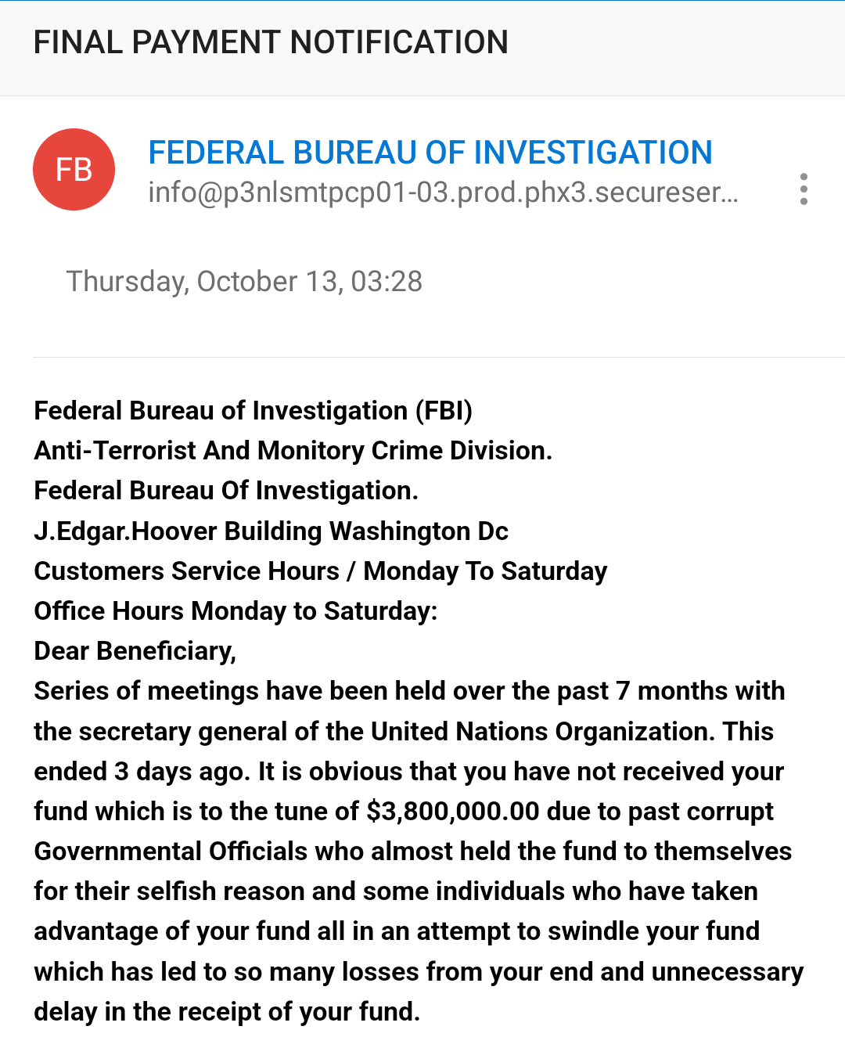
Government Imposter Scam
Methods Used in
Government
Imposter Scam:
Phone call, email, text requesting
information.
Request to send money upfront to
receive benefit.
Request to send money via wire
transfer or gift card.
Advised to keep the call/discussion
a secret.
Notes:
Asian “Chinese prosecutor/police” scam – tell the victim their passport, bank account, ID was used in money laundering, murder, prostitution case in Beijing. Need to prove their money is clean/was not involved by sending it to the Beijing police to check.

Slide 7
Grandparent/Grandchild Scam
Methods used in Grandparent/Grandchild Scam:
Scammers utilize social networking sites to uncover your PII.
Victim receives late night phone call/text begging for help.
Scammer impersonates an official (police, hospital doctor/nurse,
foreign government authority).
Stresses the urgency of a money transfer via wire/crypto currency.
Grandparent is advised to not tell victim’s parents.
Notes:
Once again, the scammer tells the victim to NOT tell anyone . . .

Slide 8
RED Flags
WARNING SIGNS:
Requesting large money transfers to foreign countries.
Missing checks, unknown financial transactions.
Repeated communication, badgering.
Monitoring of communications with family and friends.
Unsolicited requests for services, information.
Use of Remote Desktop Protocol/access.
Misspellings and/or grammatical errors in communications.
Random texts asking for your name.
You are instructed to not tell your friends and family.
YOUR INSTINCTS ARE TELLING YOU SOMETHING IS OFF!!

Slide 9
What To Do
If you are the Victim of a scam:
Notify your financial institution and listen to your banker.
Notify a family member or friend and listen to them.
Change communication methods, phone numbers, emails.
Update and enhance privacy settings on social media, email, and bank accounts.
Contact law enforcement – local PD, Federal Agency, file an IC3.
Disable Remote Desktop Protocol/access.
Assume your identity is already stolen.
Monitor your credit (Equifax, TransUnion, Experian).
LISTEN TO YOUR INSTINCTS!!!

Slide 10
Recommendations
Do NOT send money to people you do not know or have never met in person.
Do NOT convert money into gift cards.
Do NOT trust emails asking for money.
Do NOT wire money unless you are 1,000,000% percent sure it is going to a
legitimate recipient.
Do NOT let anyone remotely access to your computer. EVER.
Do NOT click on unknown links in emails, text messages, or on websites.
Do NOT open attachments in emails unless you know the sender.
NEVER provide your password for anything to anyone who asks for it over
the phone or through email.
Be careful what you post online.
Verify government and business phone numbers on the internet.
Use multiple verifications for financial transactions.
Education & Awareness – tell others your story.
PREVENTION IS CHEAPER THAN RECOVERY!!
Notes:
What business practice or when In your life have you ever been told to convert money into gift cards and send them to someone, or into bitcoin for payment?
Scammers get your personal information by searching you online.

Slide 11
Useful Websites
Local USSS Field Offices:
www.secretservice.gov/contact/field-offices
Identity Theft/Fraud Reporting – Federal Trade Commission
https://reportfraud.ftc.gov/#/
FTC Consumer Advice: https://consumer.ftc.gov/scams
Online Fraud- Internet Crime Complaint Center
https://www.ic3.gov/
Social Security Administration Fraud Hotline:
https://secure.ssa.gov/pfrf/home
Report an Incident through CISA:
https://www.cisa.gov/secure-our-world

Slide 12
Useful Websites
Phishing Scams: phishing.report@mail.cisa.dhs.gov
National Cybersecurity Communications & Integration Center
Department of Justice Senior Scam Alerts: https://www.justice.gov/elderjustice/senior-scam-alert
The Senior Source - https://theseniorsource.org (Dallas-based)

